Slide 1




ADOPTING TECHNOLOGY FOR INCLUSIVE ELECTIONS: A SOLUTION OR A PROBLEM?
Leena Rikkila Tamang, International IDEA
SUMMIT FOR DEMOCRACY - Democracy Cohort on Election Integrity
International Conference on the Use of Technology in Elections Integrity
23-24 January 2023, New Delhi, India
www.idea.int
@Int_IDEA
InternationalIDEA

Slide 2

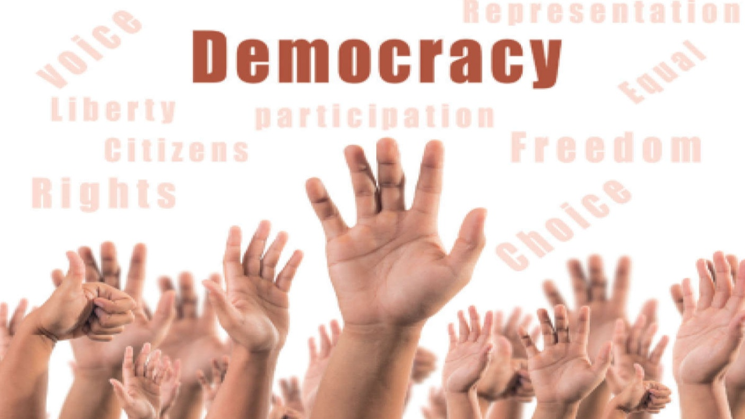
ADOPTING TECHNOLOGY FOR INCLUSIVE ELECTIONS: A SOLUTION OR A PROBLEM?
its policies, principles, processes and institutions are exposed to constant assessment, adaptation and improvement
in order to meet and reflect the concerns, needs and values of societies, as they change over time, democracy must constantly evolve
for all voices to be heard and all citizens have equal opportunities to participate in decision-making processes, democracy must be inclusive
IS A PROCESS IN A CONTINUOUS EVOLUTION

Slide 3

ADOPTING TECHNOLOGY FOR INCLUSIVE ELECTIONS: A SOLUTION OR A PROBLEM?
promotes fairness and justice
helps preventing the marginalization of certain segments of society
promotes social cohesion and stability
allows citizens to feel that their rights and freedoms are protected
and that they have a stake, and a say, in the future and the prosperity of their country
INCLUSIVE DEMOCRACY

Slide 4
ADOPTING TECHNOLOGY FOR INCLUSIVE ELECTIONS: A SOLUTION OR A PROBLEM?
leads to lack of representation
restricted access to political power
economic disparities and social division
unequal and inequitable participation
disengaged citizenry and electorates
political instability and polarisation
limited government effectiveness and accountability
NON-INCLUSIVE DEMOCRACY

Slide 5
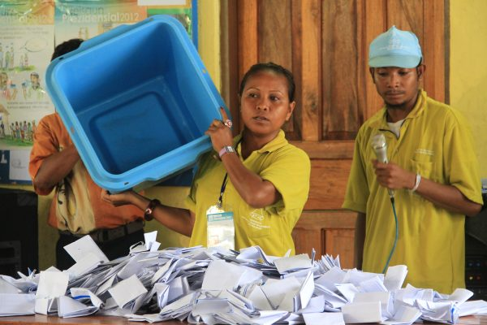
ADOPTING TECHNOLOGY FOR INCLUSIVE ELECTIONS: A SOLUTION OR A PROBLEM?
the conduit through which all members of a society are able to participate in their country’s political process
express a say in shaping key decisions affecting their lives
the more inclusive an election is, the greater the likelihood that all voices and perspectives will be heard and represented in the final outcome
INCLUSIVE ELECTIONS

Slide 6
ADOPTING TECHNOLOGY FOR INCLUSIVE ELECTIONS: A SOLUTION OR A PROBLEM?
INCLUSIVE ELECTIONS
BARRIERS
restrictive voting eligibility qualifications are often used to exclude certain groups from the suffrage and be fairly represented in the election process, limiting their voting access
REQUIREMENTS
all eligible citizens must have the right to vote and participate in the election without discrimination or barriers, without fear of repression or intimidation
Equal and universal suffrage
Professional, fair and impartial electoral administration
the legal framework governing the electoral process must protect the rights of all citizens
poorly managed, biased and fraudulent electoral administration undermines the integrity and credibility of the electoral process, ultimately discouraging citizens from participating
ensure neutral and unbiased administration that is committed to ensuring the integrity of the process
all political parties and candidates must have equal opportunities to compete

Slide 7
ADOPTING TECHNOLOGY FOR INCLUSIVE ELECTIONS: A SOLUTION OR A PROBLEM?
INCLUSIVE ELECTIONS
BARRIERS
lack of transparency and accountability undermines stakeholder trust in the electoral process and the legitimacy of its outcome
REQUIREMENTS
the electoral process must be transparent and open to public scrutiny, with mechanisms in place to investigate and address any complaints or allegations of misconduct
Transparency and accountability
Physical accessibility to voting
elections must be accessible to all citizens, including those with disabilities or special needs, or minority populations
legal, procedural or physical barriers limit access to voting, preventing marginalised groups from participating in elections
Access to information
citizens, political actors, civil society organisations and the media must enjoy access to accurate and unbiased information about the electoral process
barriers preventing or limiting access to accurate and unbiased information prevent informed decision making and meaningful electoral participation

Slide 8




ADOPTING TECHNOLOGY FOR INCLUSIVE ELECTIONS: A SOLUTION OR A PROBLEM?
EXCLUSION
FROM POLITICAL PROCESSES, REPRESENTATION AND DECISION MAKING
their political discrimination & marginalization is perpetuated and exacerbated
only certain interests and concerns are voiced, represented and acted upon
resulting policies and decisions only benefit represented individuals or groups while openly neglecting those excluded
this gives way to a polarized political and social climate, where marginalised individuals or groups feel disenfranchised and excluded
when the voices of certain individuals or groups are silenced
to make their silenced voices heard, they may resort to civil disobedience, social unrest, and even to violence

Slide 9

ADOPTING TECHNOLOGY FOR INCLUSIVE ELECTIONS: A SOLUTION OR A PROBLEM?
USE OF TECHNOLOGY
enhance the inclusiveness, efficiency and integrity of elections and address new and evolving threats always coming their way
Voter registration ​
Voter identification ​
Results tabulation & transmission​
Electronic voting (e-voting) and counting​
EMB internal communication and data management ​
EMB external communication (website, social media)​
Party and candidate registration​

Slide 10
ADOPTING TECHNOLOGY FOR INCLUSIVE ELECTIONS: A SOLUTION OR A PROBLEM?
USE OF TECHNOLOGY
Voting and Results Technology – Global Usage and Trends
Online voting
Vote casting and counting in polling stations
Result publication
Result transmission from polling stations
Local level recapitulation/ transmission
Polling station detail result publication

Slide 11
ADOPTING TECHNOLOGY FOR INCLUSIVE ELECTIONS: A SOLUTION OR A PROBLEM?
USE OF TECHNOLOGY
If effectively designed, introduced and maintained, technology can:
improve the efficiency, speed, accuracy, and reliability of key electoral operations
address procedural shortcomings and, by reducing reliance on human intervention, also limit human error
enhance election integrity by reducing or preventing opportunities for manipulation, irregularities and fraud
foster electoral inclusion by facilitating voting access and convenience to segments of the electorate traditionally marginalised or excluded from the franchise

Slide 12
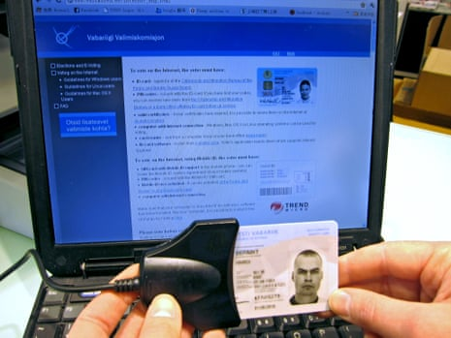
ADOPTING TECHNOLOGY FOR INCLUSIVE ELECTIONS: A SOLUTION OR A PROBLEM?
USE OF TECHNOLOGY
Country examples of successful use of technology in elections:
Estonia has been using internet voting since 2005 and has consistently ranked as one of the top countries in the world in terms of election transparency and accuracy

Slide 13
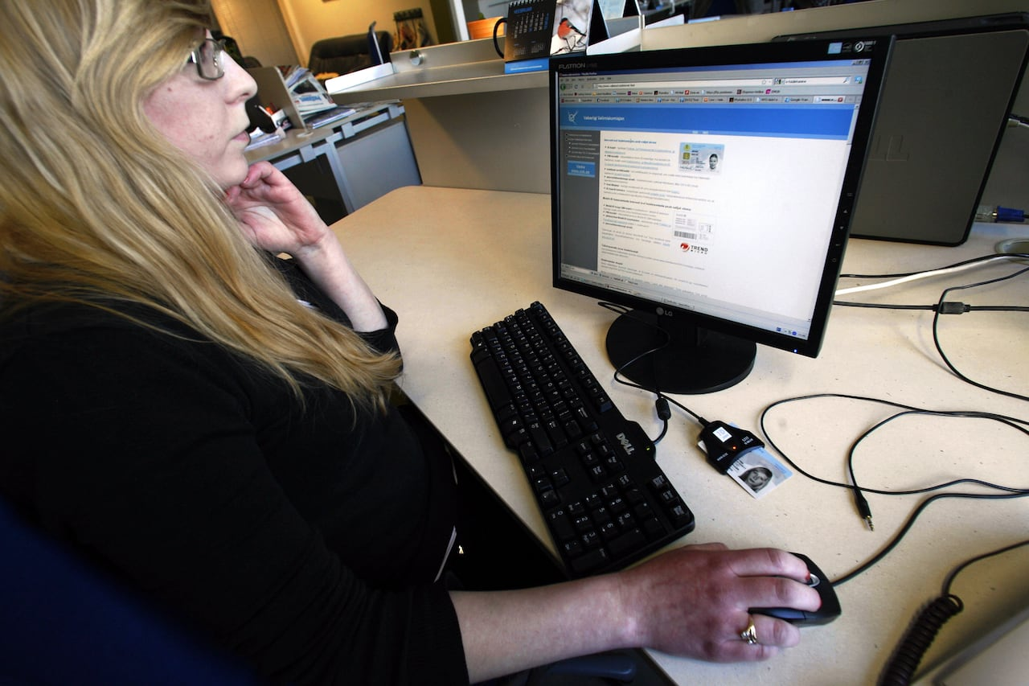
ADOPTING TECHNOLOGY FOR INCLUSIVE ELECTIONS: A SOLUTION OR A PROBLEM?
USE OF TECHNOLOGY
Country examples of successful use of technology in elections:
Canada used internet voting in some jurisdictions during the 2019 federal election allowing for greater accessibility for voters living in remote areas or with disabilities

Slide 14
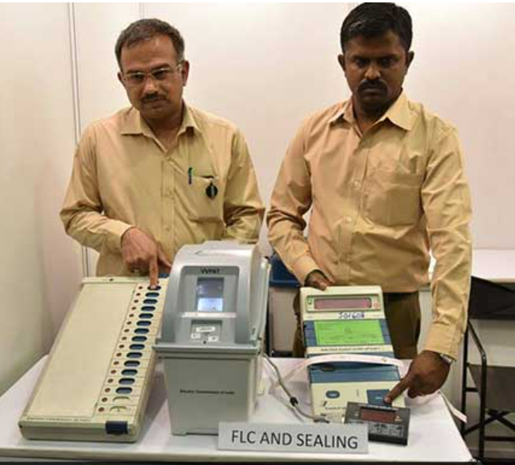
ADOPTING TECHNOLOGY FOR INCLUSIVE ELECTIONS: A SOLUTION OR A PROBLEM?
USE OF TECHNOLOGY
Country examples of successful use of technology in elections:
India has been using Electronic Voting Machines (EVMs) since 1999 and it has helped in quick counting and reducing the chances of errors and invalid ballots

Slide 15
ADOPTING TECHNOLOGY FOR INCLUSIVE ELECTIONS: A SOLUTION OR A PROBLEM?
USE OF TECHNOLOGY
If instead poorly designed, introduced and maintained, technology can:
challenge consolidated democratic norms and principles
undermine how elections work and both their actual and perceived integrity
create vulnerabilities, opening up new domains for manipulation, fraud, fuelling mistrust
make the electoral process slow and inefficient, prone to errors, delaying or undermining key electoral operations
limit voting accessibility, exacerbate political exclusion and discourage participation

Slide 16
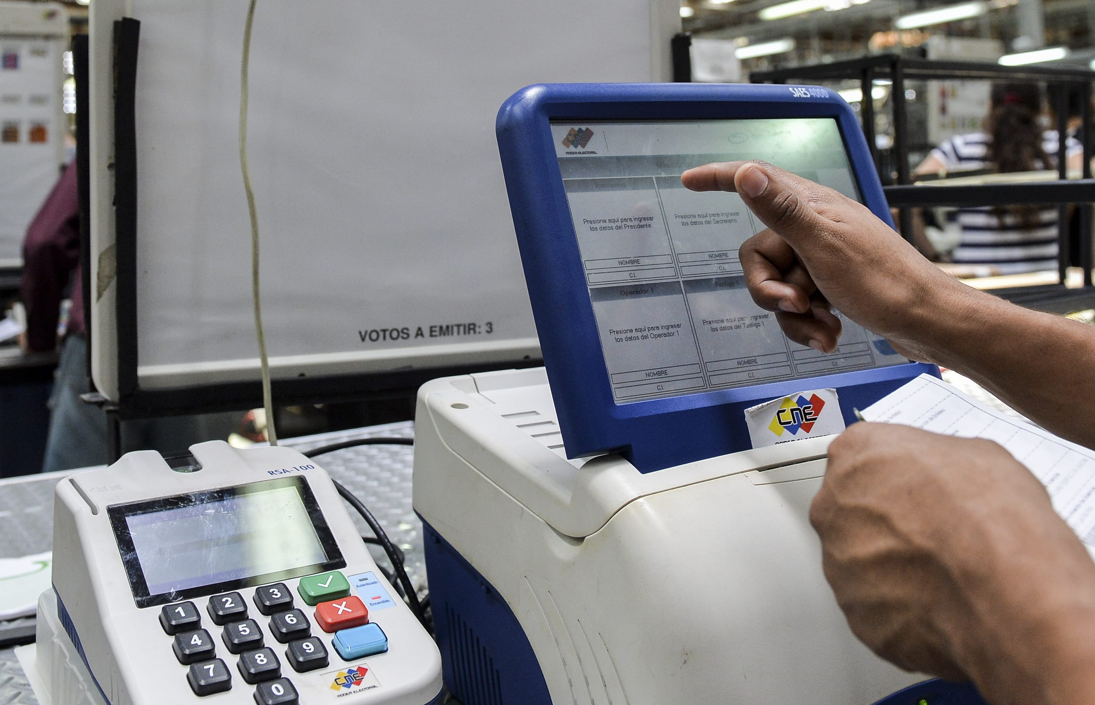
ADOPTING TECHNOLOGY FOR INCLUSIVE ELECTIONS: A SOLUTION OR A PROBLEM?
USE OF TECHNOLOGY
Country examples of unsuccessful use of technology in elections:
In Venezuela’s 2018 presidential election, the use of a blockchain-based voting system was met with widespread skepticism and allegations of manipulation and fraud

Slide 17
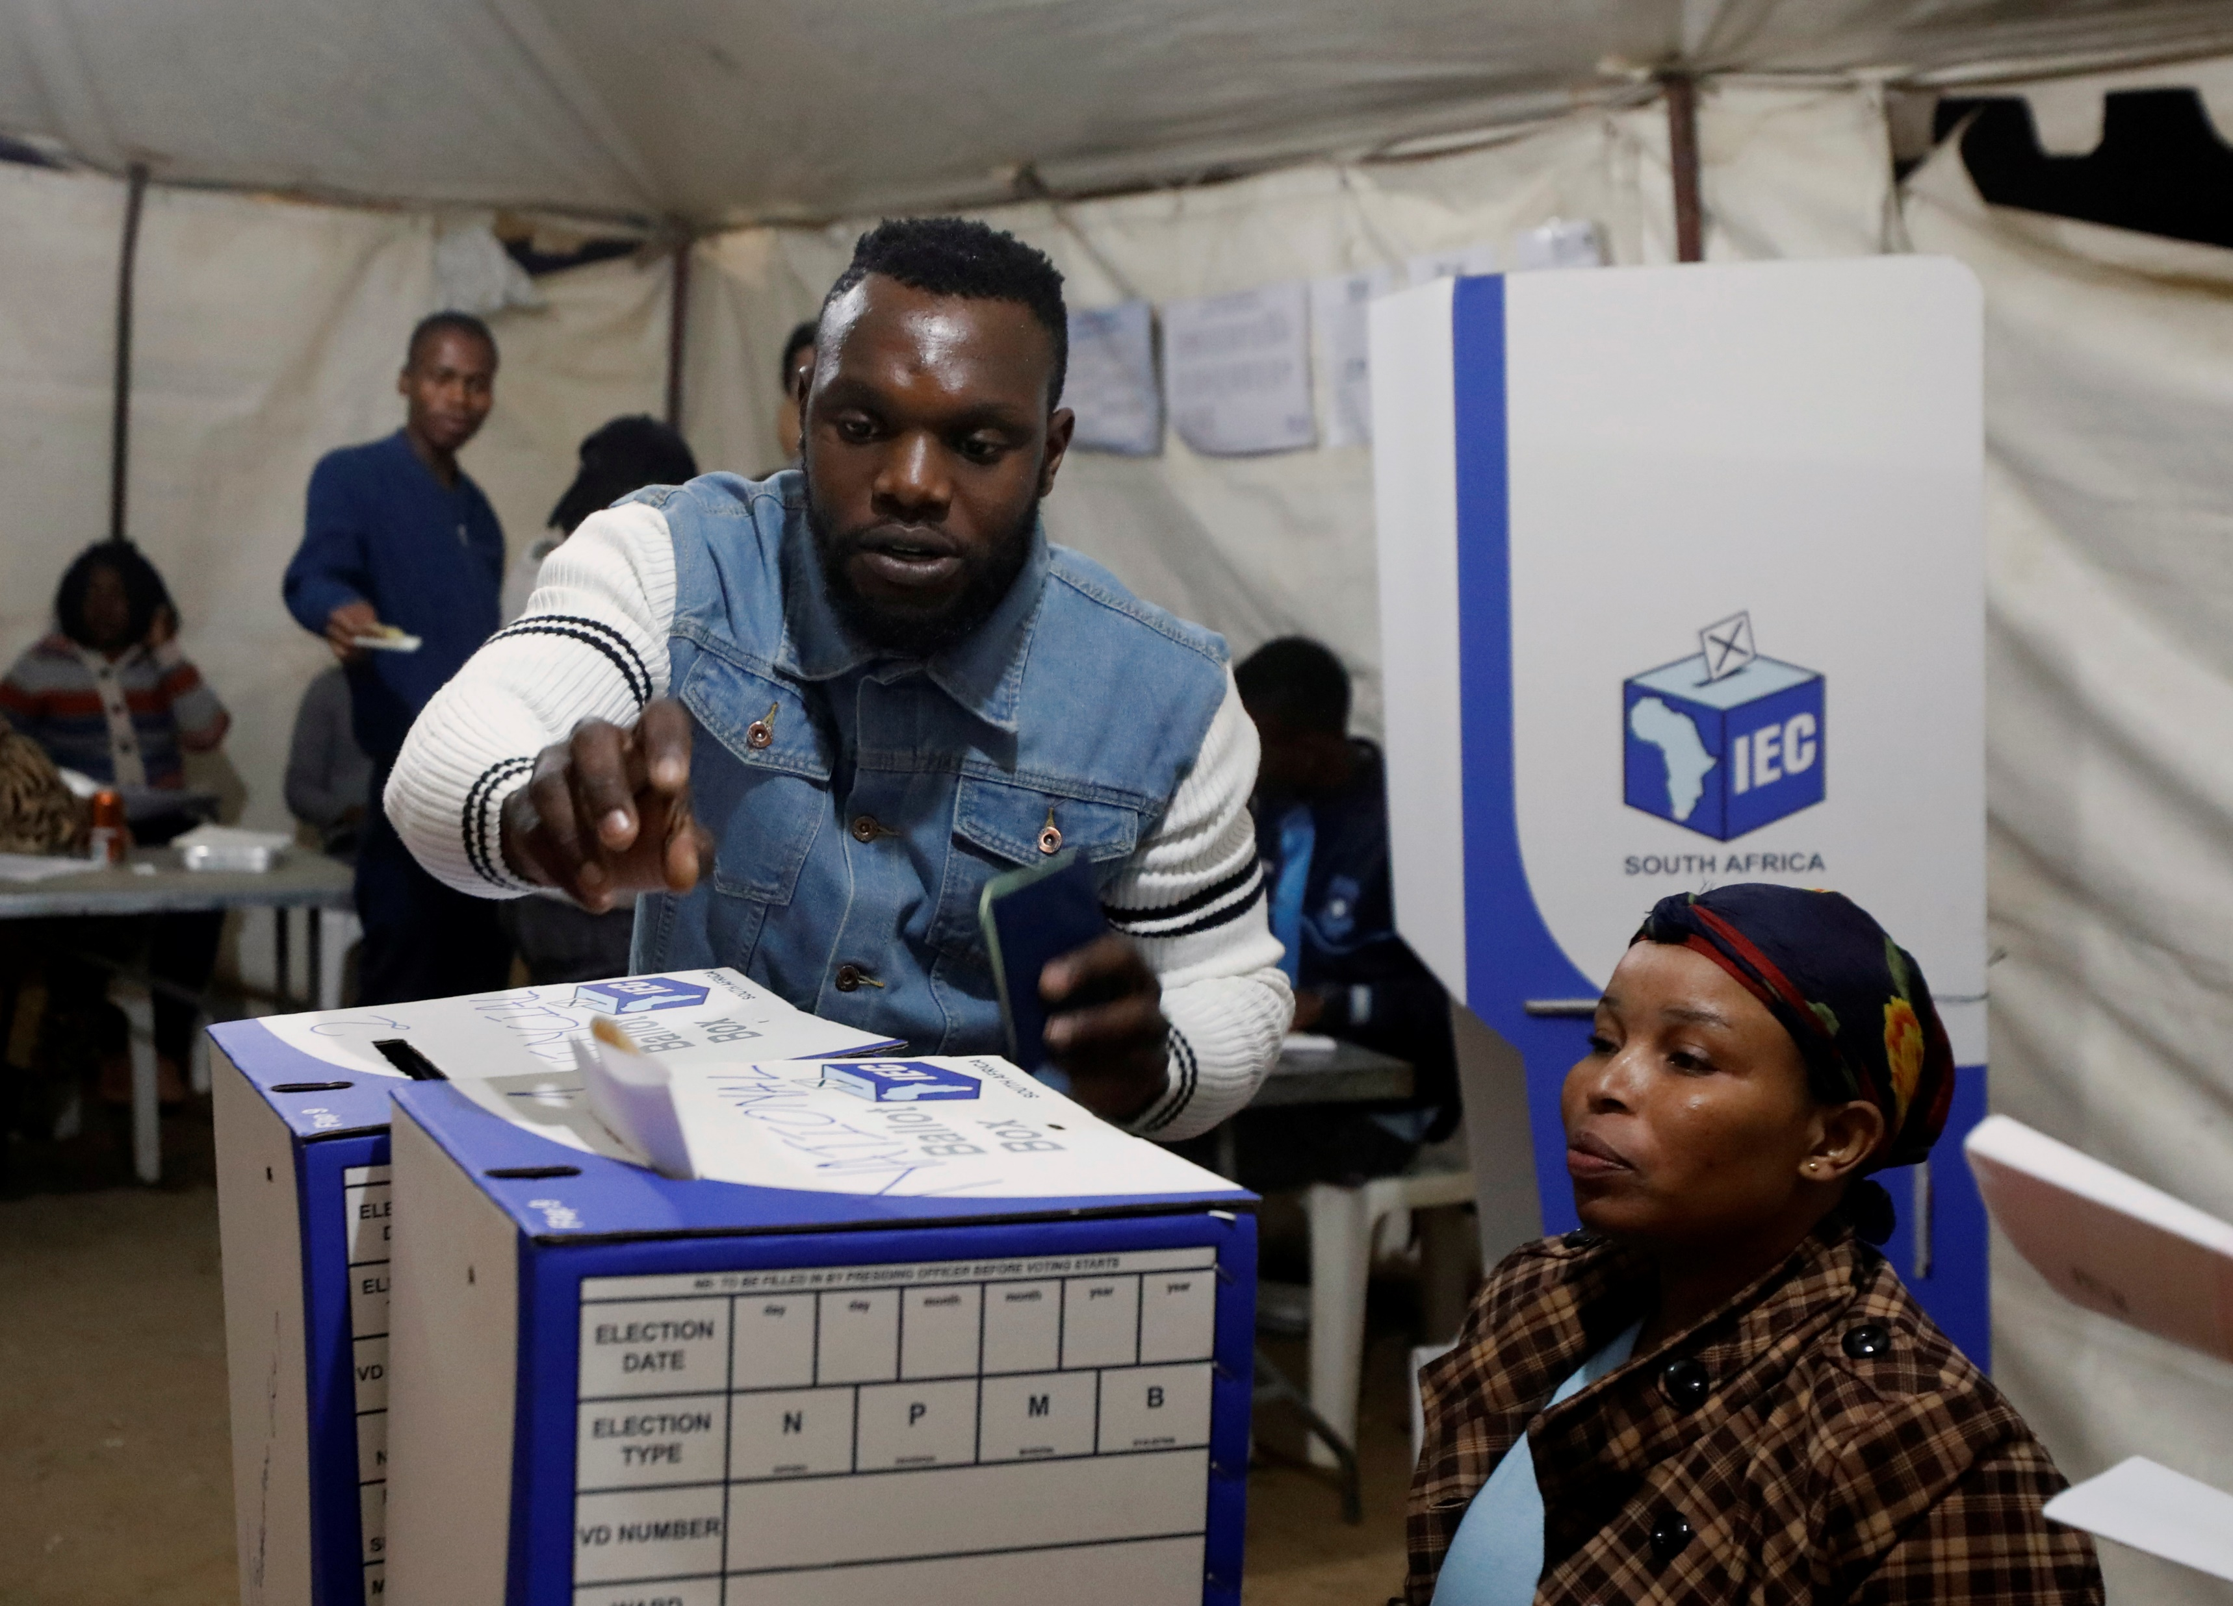
ADOPTING TECHNOLOGY FOR INCLUSIVE ELECTIONS: A SOLUTION OR A PROBLEM?
USE OF TECHNOLOGY
Country examples of unsuccessful use of technology in elections:
South Africa’s 2019 general election, experienced technical difficulties with the voting system, causing delays and long lines at polling stations. These issues were attributed to a lack of training and inadequate preparation

Slide 18
ADOPTING TECHNOLOGY FOR INCLUSIVE ELECTIONS: A SOLUTION OR A PROBLEM?
USE OF TECHNOLOGY
many considerations must be factored into both the design, introduction and maintenance of technology in support of a more inclusive election
the numerous unforeseen risks which technology inherently involves (particularly those relating to its inappropriate or untimely introduction) must be carefully weighed in
when seeking to introduce technological solutions to maximise inclusion in their elections, how may an EMB effectively consider and assess all risks?

Slide 19
ADOPTING TECHNOLOGY FOR INCLUSIVE ELECTIONS: A SOLUTION OR A PROBLEM?
USE OF TECHNOLOGY
Does the technological solution contribute to enhance the inclusion of all eligible voters, their equal access to, and participation in, the franchise?
Does it enjoy public trust and broad political consensus obtained through the meaningful engagement of all key electoral stakeholders in its design and introduction?
Is it fit for the purpose that it was designed to achieve and the service that it must provide to the electorate?
Was it developed locally, independently, so that it is best tailored to the specific needs, cultural context, and existing capacities and infrastructure in which it must be deployed, maintained and sustained over multiple election cycles?
Is the timing of its deployment opportune and realistic?
Is it efficient, affordable, upgradable, cost effective, does it seek to achieve the maximum results at the lowest cost?

Slide 20
ADOPTING TECHNOLOGY FOR INCLUSIVE ELECTIONS: A SOLUTION OR A PROBLEM?
USE OF TECHNOLOGY
Is the adopted solution flexible enough to be adapted to existing legal framework or can it be realistically introduced through new election regulations?
Is it user-friendly, simple, and understandable for those having to use it, both on the operator/user’s ends?
Does it offer appropriate safeguards to guarantee its ethical, transparent, professional and unbiassed use by those having to operate it?
Is it reliable and secure, having been developed through extensive testing, auditing, verification and certification?
Has its introduction been based on a realistic assessment, comparative research/analysis of similar systems, practices and experiences in other jurisdictions and on learning from their successes and failures?
Does it ensure transparency while simultaneously maintaining secrecy and privacy – especially where sensitive data is processed?
Has its maximum usability been ensured, by training those having to operate it and by informing and educating the electorate on its use?

Slide 21
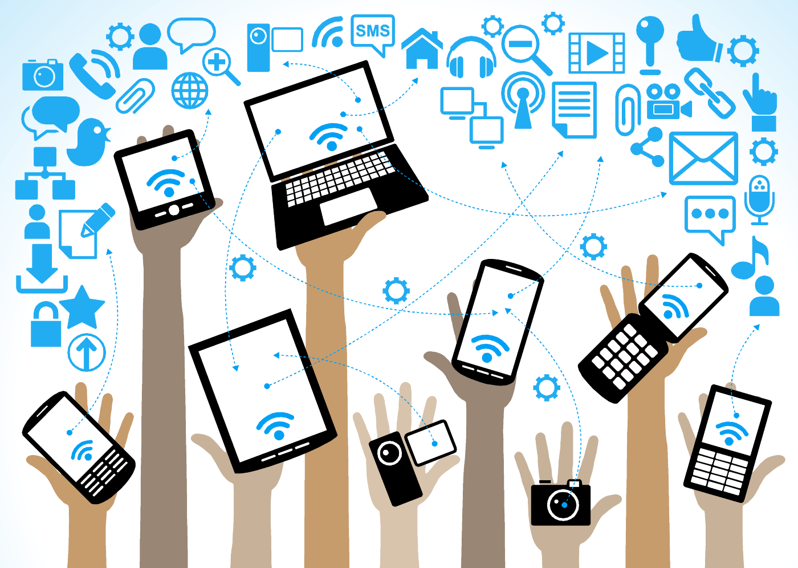
ADOPTING TECHNOLOGY FOR INCLUSIVE ELECTIONS: A SOLUTION OR A PROBLEM?
the benefits involved in the inevitable increase in the use of technology to support electoral inclusion are manyfold and obvious
EMBs should continue to carefully consider the tensions that often arise in the management of elections
BENEFITS OF TECHNOLOGY

Slide 22

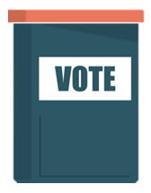
ADOPTING TECHNOLOGY FOR INCLUSIVE ELECTIONS: A SOLUTION OR A PROBLEM?
key among these tensions is the EMB’s ability to navigate between:
efforts for greater inclusion, accessibility and voting convenience
urging EMBs not only to bring the voter to the ballot box
THE PARTICIPATION DIVIDEND
THE INTEGRITY THREAT

Slide 23

ADOPTING TECHNOLOGY FOR INCLUSIVE ELECTIONS: A SOLUTION OR A PROBLEM?
but also – through the use of technology –bringing the ballot box to the voter
the EMB’s constant need to strengthen and protect electoral integrity from:
the genuine risks that increase the further the ballot box moves away from the controlled environment of the polling station
THE PARTICIPATION DIVIDEND
THE INTEGRITY THREAT

Slide 24
ADOPTING TECHNOLOGY FOR INCLUSIVE ELECTIONS: A SOLUTION OR A PROBLEM?
key among these tensions is the EMB’s ability to navigate between:
but also – through the use of technology –bringing the ballot box to the voter
the EMB’s constant need to strengthen and protect electoral integrity from:
from the genuine risks that increase the further the ballot box moves away from the controlled environment of the polling station
new threats constantly emerging and attempting to erode public trust in the integrity of the electoral process and the legitimacy of its outcome
BIASED EMB!
STOLEN ELECTION!
FRAUD!
THE PARTICIPATION DIVIDEND
THE INTEGRITY THREAT

Slide 25

Voters ready for and expecting more convenience, better access
Spoilers trying to undermine credibility of elections
EMB must protect elections and provide service for voters
Election
Technology
www.idea.int

Slide 26

THANK YOU!
INTERNATIONAL IDEA’s Databases and Tools
www.idea.int
@Int_IDEA
InternationalIDEA

