Slide 1
Nonviolent Collective Action
—
Workstream on Cross-Border Support for Nonviolent Collective Action
Neetha Tangirala, USAID
Benjamin Naimark-Rowse, USAID
Hardy Merriman, ICNC

Slide 2
Meeting Outline
Introductions
Overview of Evidence for Nonviolent Collective Action and Cross-Border Support for It
Discussion Questions
Next Steps

Slide 5
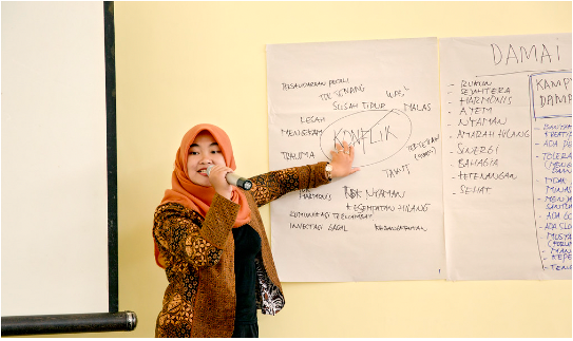
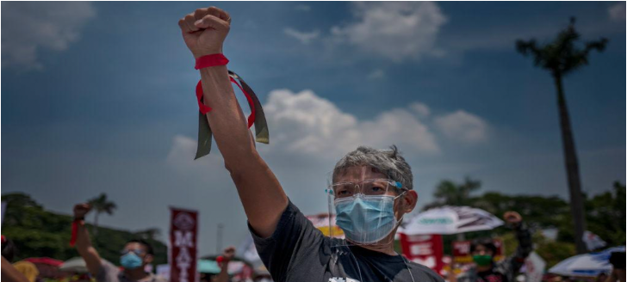
What is Nonviolent Collective Action (NVA)?
NVA involves regular people collectively building power in their societies
and applying that power without the threat or use of violence.
Notes:
Nonviolent collective action is a core strategy of civic participation.
It involves regular people building power collectively in their societies and applying that power without the threat or use of violence.
It is interchangeably referred to as nonviolent resistance or civil resistance.
At its core, the story of nonviolent collective action is a story about extra-institutional, people-powered politics.

Slide 6
Myth - Nonviolent Collective Action Occurs Only in Revolutionary Social Movements
Nonviolent collective action is often visible - in our streets and squares. But it is so much more than revolutionary street protests.
In some contexts it involves grassroots organizing at the local level. In other contexts it entails creating a social movement at the regional or national level.
Nonviolent collective action can occur as part of a social movement or outside of a movement. And it can be used for revolutionary or reformist goals.
Notes:
We often notice nonviolent collective action because it is visible - in our streets and squares - that is, primarily outside of formal political institutions like political parties. But nonviolent collective action is much more than revolutionary street protests. It can entail acts of commission such as sit-ins or work slowdowns. And it can entail acts of omission such as boycotts or refusing to pay taxes.
Nonviolent collective action can entail grassroots organizing to build political power at a local level - for example, to improve public services like education or trash collection. Alternatively, it can entail mass mobilization at a regional or national level - for example, to demand anti-corruption legislation.
So when we say nonviolent collective action it refers to people building power primarily outside of formal political institutions. And seeking a range of goals – from policy reform, to regime change, to criminal accountability.

Slide 7
Evidence: NVA Has Led to Democratic Gains
Political transitions via nonviolent collective action have been 3x as likely to lead to democracy compared to transitions by any other means
Nonviolent collective action has curtailed corruption and ushered in democratic innovations from below on multiple continents
Nonviolent collective action has been 2x more effective than violence
People are using nonviolent collective action more than ever before
Notes:
Why does nonviolent collective action matter? As a scholar I go to the data.
Extensive scholarship has found that nonviolent collective action in the form of social movements and grassroots organizing has strengthened and protected democracy in every region of the world. We’re all familiar with democratic backsliding and rising authoritarianism. But I’d pose to you that many countries might be even worse off if it weren’t for nonviolent collective action. Four data points stand out.
First, political transitions initiated through nonviolent collective action are THREE TIMES as likely to lead to democracy as political transitions initiated though all other means. A business person considering where to invest their funds would - all else equal - surely pick the strategy that is 3x as likely to succeed.
Next, nonviolent collective action has curtailed corruption and sparked democratic innovations from below. These innovations are - for example - often related to participatory and deliberative practices including “crowd-sourced constitutions,” referenda, and political parties built on the shoulders of years of work by grassroots organizers.
Third. nonviolent collective action is TWICE as effective as violence at achieving the stated goals of those using it.
Finally, we’re living in an era where people around the world are using nonviolent collective action more than ever before in recorded history.
In short, nonviolent collective action is not only effective, it is ubiquitous.

Slide 8
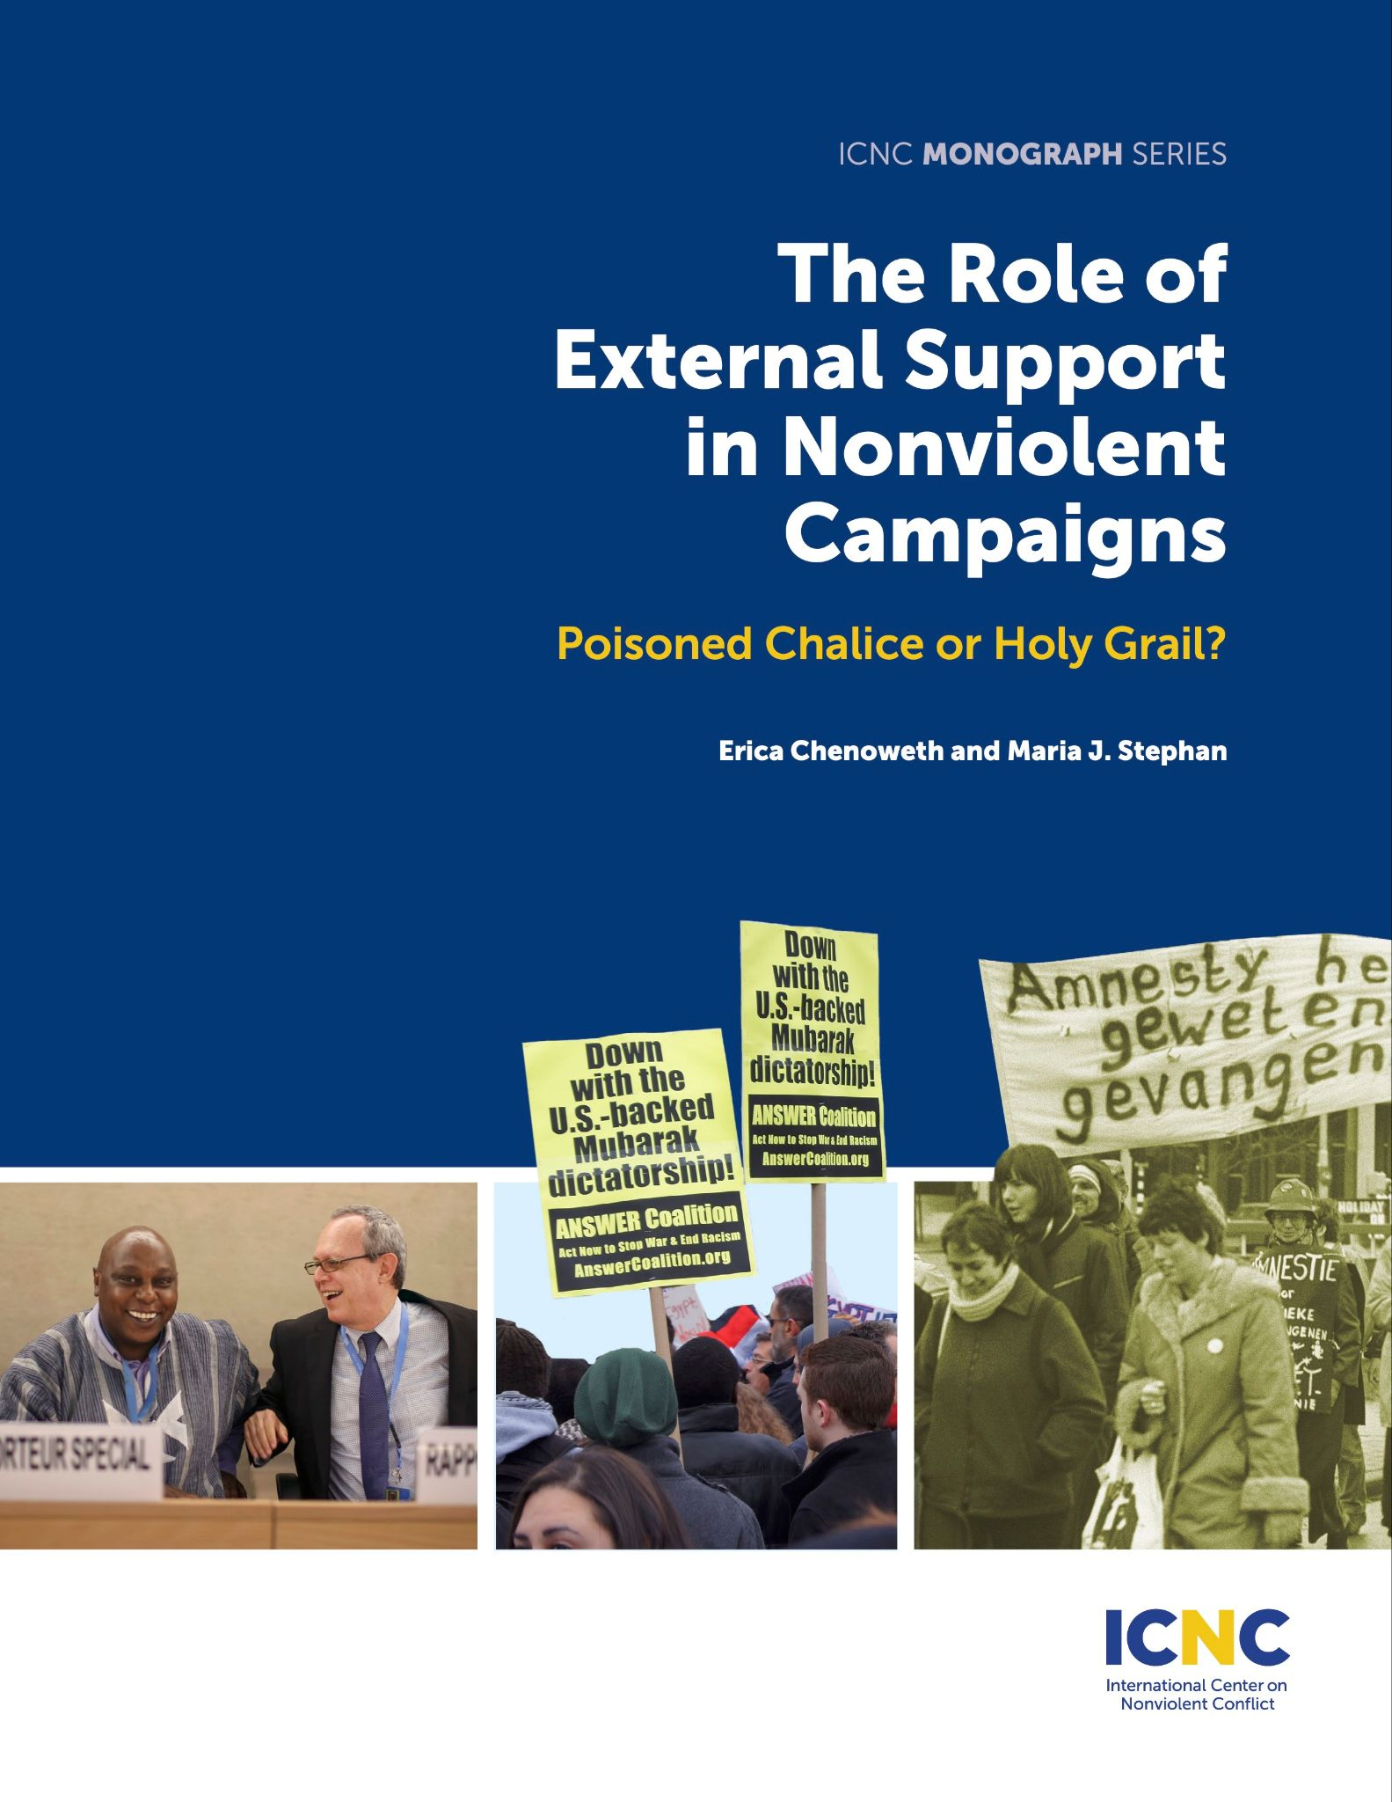
What We Know: The Evidence
Quantitative evaluation:
68 maximalist campaigns
Qualitative evaluation:
8 maximalist campaigns from 2000-2013

Slide 9
What We Know: The Evidence
Training is helpful:
“… activists who receive training prior to peak mobilization are much more likely to mobilize campaigns with high participation, low fatalities, and greater likelihood of defections.”

Slide 10
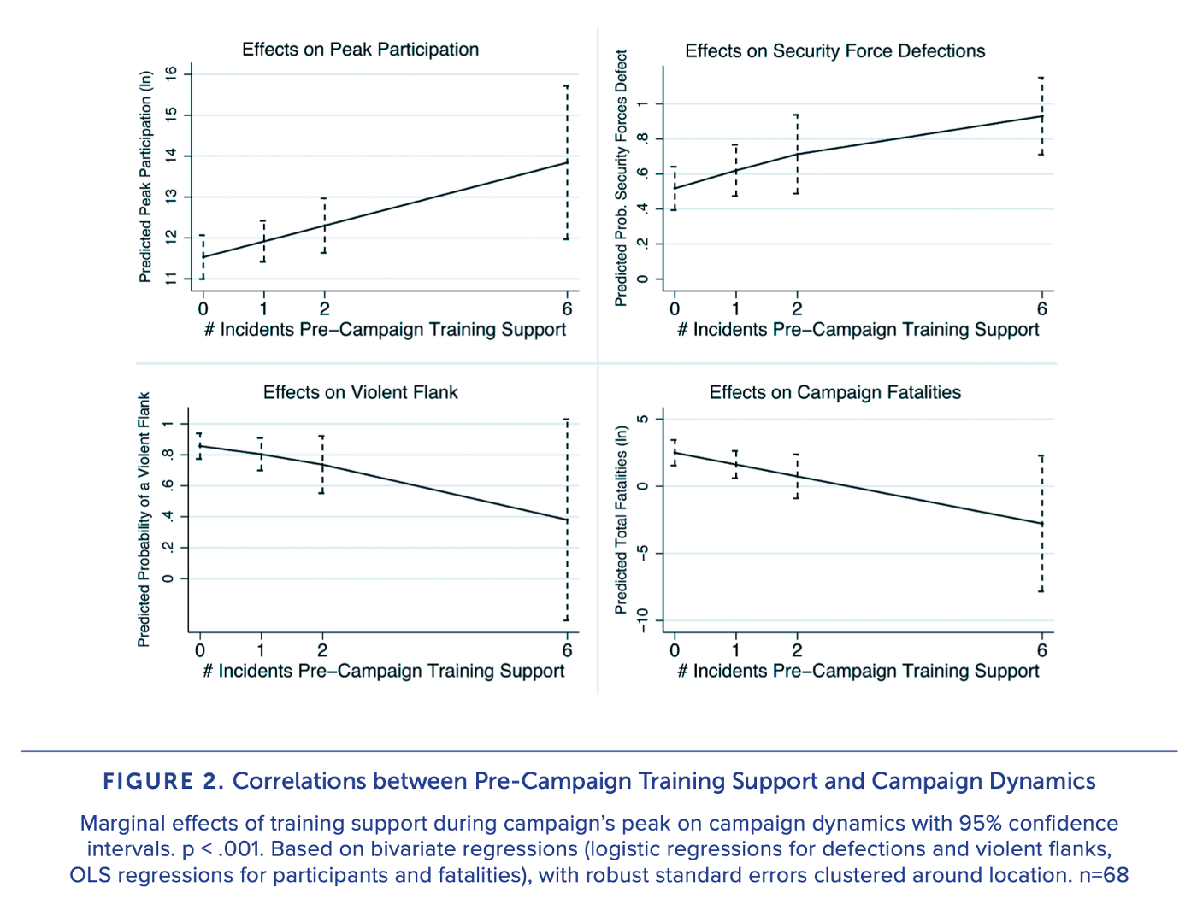
Notes:
Daniel

Slide 11
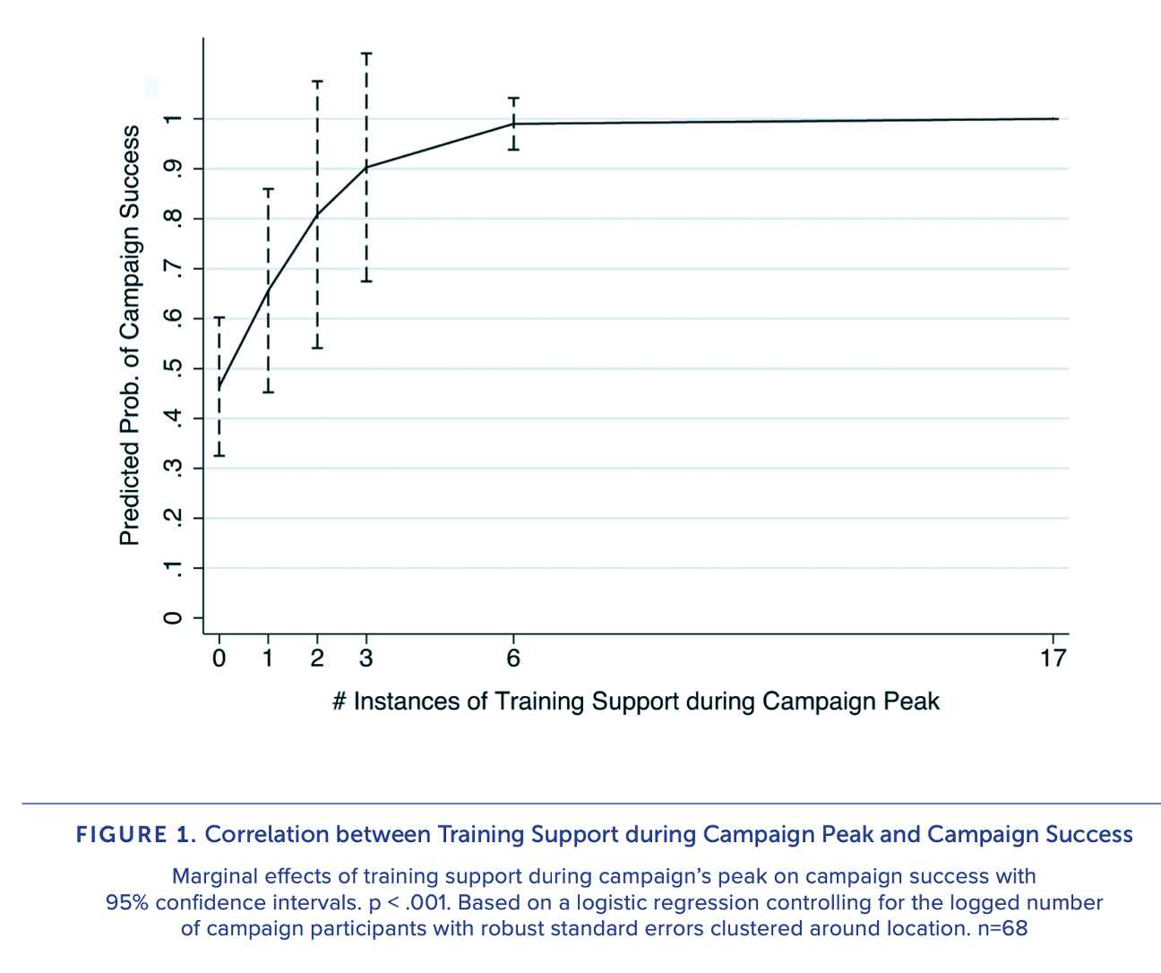

Slide 12
What We Know: The Evidence
Deterring and raising the cost of repression is helpful:
“… mitigating regime repression via political, diplomatic, and security engagement is a critical form of assistance that supports an enabling environment for nonviolent organizing and mobilizing.”
Notes:
Daniel

Slide 13
What We Know: The Evidence
Indirect government support is helpful:
“… government assistance can indirectly support nonviolent campaigns. But in general, states seem to be most involved after the campaign has ended—serving as a critical check on transitioning governments.”
Notes:
Daniel

Slide 14
What We Know: The Evidence
Support to armed groups is harmful:
“… concurrent external support to armed groups tends to undermine nonviolent movements in numerous ways…. Support to armed organizations is correlated with lower participation rates, lower chances of maintaining nonviolent discipline, lower chances of eliciting security force defections, and lower chances of movement success.”
Notes:
Daniel

Slide 15
What We Know: The Evidence
Direct funding has ambiguous effects:
“… direct funding to movements has few generalizable effects on movement characteristics or outcomes. The only statistically significant finding suggests that direct financial assistance to movements is correlated with fewer participants in the campaign, suggesting it has adverse effects on a vital movement characteristic.”
Notes:
Daniel

Slide 16
What We Know: The Evidence
Coordination of external support is critical:
“… donor coordination is important to be able to effectively support and leverage nonviolent campaigns. Numerous interview respondents pointed out the necessity of alignment and coordination among donors in supporting movements, which occurred surprisingly infrequently.”
Notes:
Daniel

Slide 17
Discussion Questions
What questions do you have about engaging with nonviolent collective action and social movements?
In what ways is your government currently engaging with nonviolent collective action and social movements? What future plans or strategies are developing to do so?
Notes:
Daniel

Slide 18
Next Steps
Is there interest in having this be a formal workstream?
Notes:
Daniel

Slide 19
Questions

